Slide 1
MARKETING INVESTMENT ON VARIOUS TACTICS

Slide 2
DATA EXTRACTION
Data Set taken Adobe Campaign (Marketing Automation Tool) and Salesforce (Sales CRM).
Merged the data from 2 different platforms and came up with necessary metrics.

Slide 3
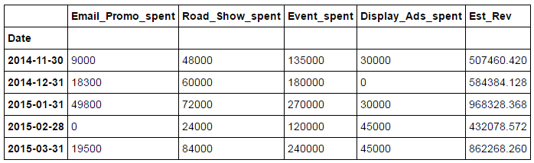
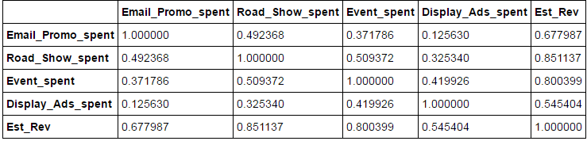
ANALYSING WHICH TATCTIC IMPACTED EST REV
Rolled up the spent on tactics $ into monthly
Observed the relationship between each features
From this relationship, we can observe that road show & Event did well

Slide 4
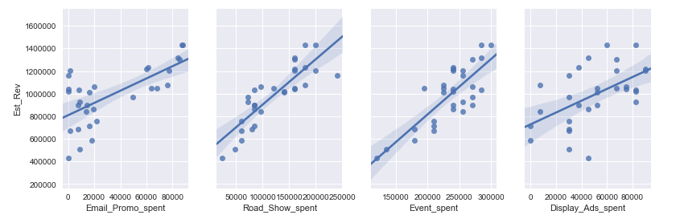
VISUALIZATION
We can observe that there is a clear relation exists between road show & est rev and event & est rev

Slide 5
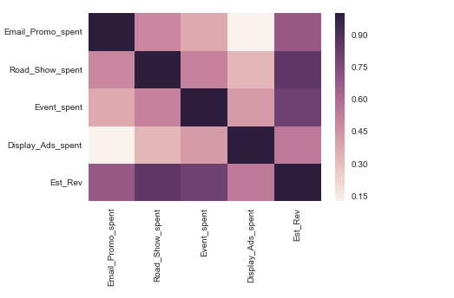
VISUALIZATION
From heat map also,we can observe that there is a clear relation exists between road show & est rev and event & est rev

Slide 6
MACHINE LEARNING
Applying linear regression model to analyze further more on which combination of features influenced the est rev.
### SCIKIT-LEARN ### Multiple linear regression
# create X and y
feature_cols = ['Email_Promo_spent', 'Road_Show_spent', 'Event_spent','Display_Ads_spent']
X = by_monthly_spent[feature_cols]
y = by_monthly_spent.Est_Rev
# instantiate and fit
linreg = LinearRegression()
linreg.fit(X, y)
# pair the feature names with the coefficients
zip(feature_cols, linreg.coef_)
[('Email_Promo_spent', 2.3188024969501608),
('Road_Show_spent', 2.1168734681833841),
('Event_spent', 2.3211878455923021),
('Display_Ads_spent', 1.957774790230864)]
For a given amount of Road Show, Event & Display ads spending, an increase of $1000 in Email Promo spending is associated with an increase in est rev of 2.31.
For a given amount of Email Promo, Event & Display ads spending, an increase of $1000 in Road Show spending is associated with an increase in est rev of 2.11.
For a given amount of Email Promo, Road Show & Display ads spending, an increase of $1000 in Event spending is associated with an increase in est rev of 2.32.
For a given amount of Email Promo, Road Show & Event spending, an increase of $1000 in Display Ads spending is associated with an increase in est rev of 1.95.

Slide 7
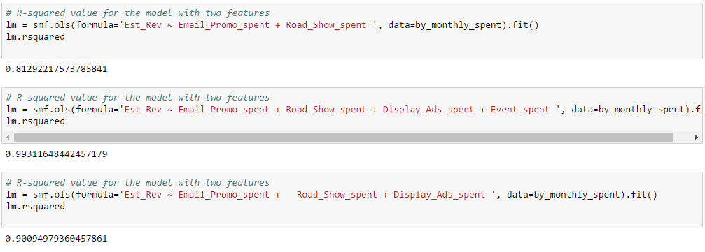
MACHINE LEARNING
Computed R-squared value with combination of various features
From above, we can conclude that combination all the features have same weightage of influence over the est rev

Slide 8
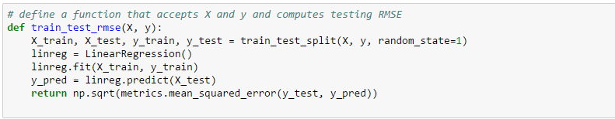
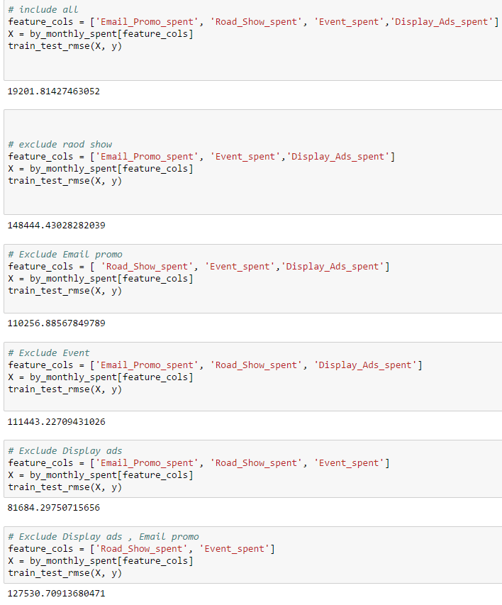
MACHINE LEARNING
Using train/test split for feature selection
From this we can conclude that collectively 4 features will influence the est rev.

